Slide 1


HR Management System

Slide 2

1
Introduction

Slide 3
The HR Management System (HRMS) is built on .NET Core, providing a seamless solution for managing employee and applicant data. It replaces traditional manual processes and integrates smoothly with existing IT systems. Accessible via standard web browsers, the system streamlines HR operations efficiently.

Slide 4
Tech Stack

Slide 5





.NET Core with Entity Framework Core
Angular
SQL Server Management Studio
.NET Identity Library
Swagger
Azure

Slide 6
Modules

Slide 7
Attendance
Payroll
Organization Settings
Authentication and Authorization
Deployement

Slide 8
Work Distribution

Slide 9
Employee CRUD
Department CRUD
Payroll calculation and optimization
Deployment in Azure
VAIBHAV
Users CRUD
Attendance update with Excel sheets
Authorization and authentication
Holidays management
ANISH

Slide 10
Architecture

Slide 11
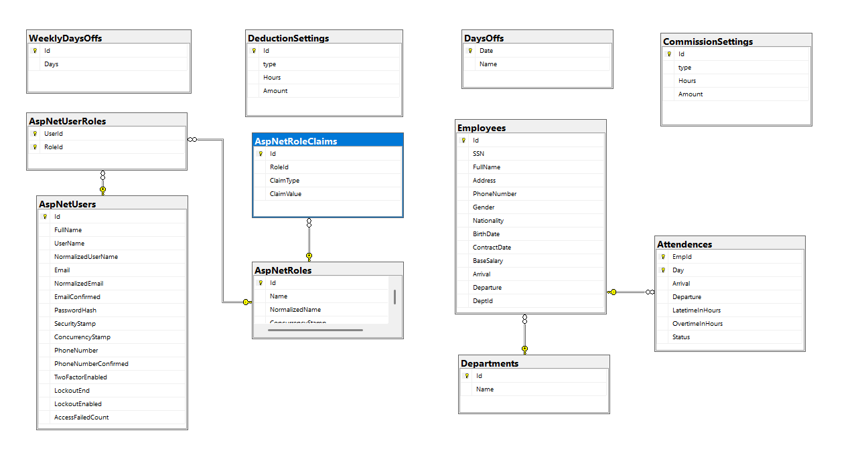
ER Diagram

Slide 12
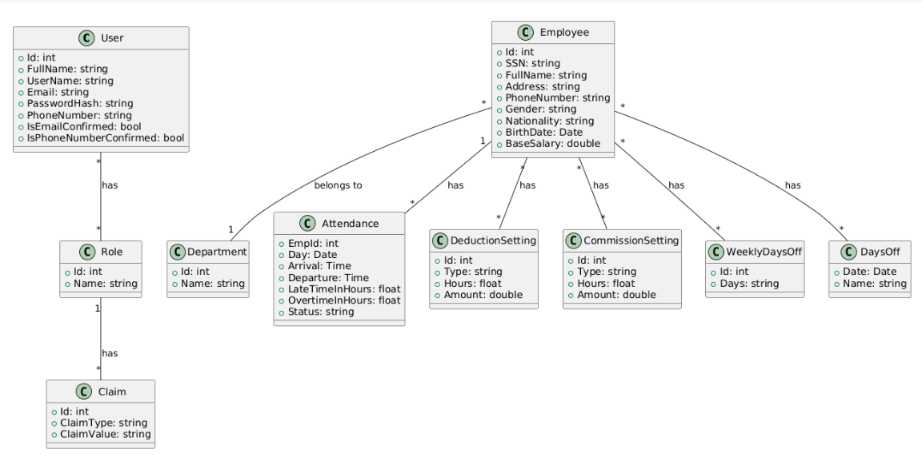
Class Diagram

Slide 13
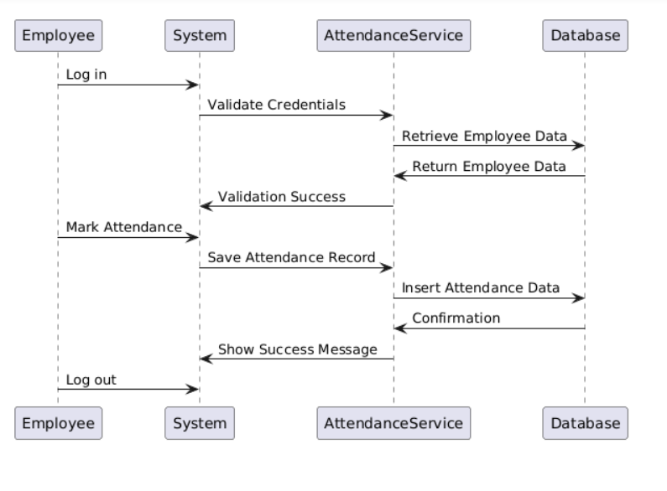
Sequence Diagram - Attendence Management

Slide 14
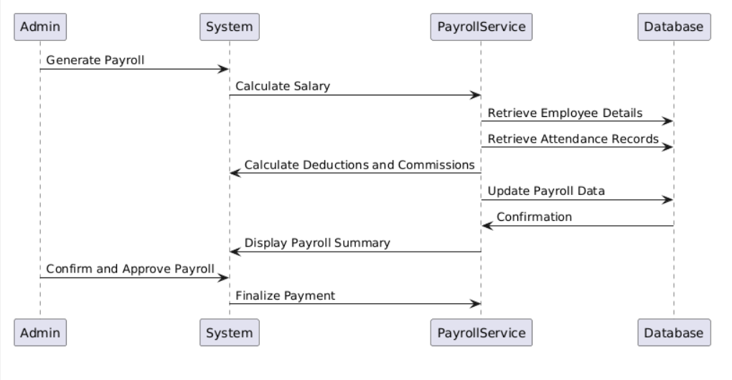
Sequence Diagram - Payroll Management

Slide 15
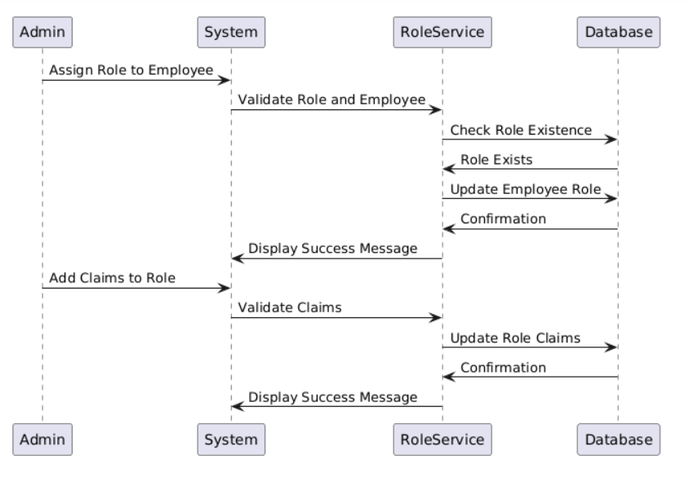
Sequence Diagram - Roles Management

Slide 16
Special Bits

Slide 17
Bulk Update of Attendance uses the same excel format as generated by Biometric Attendance System
Payroll Calculation using Stored Procedures on Database Server, for optimized operation over large dataset

Slide 18
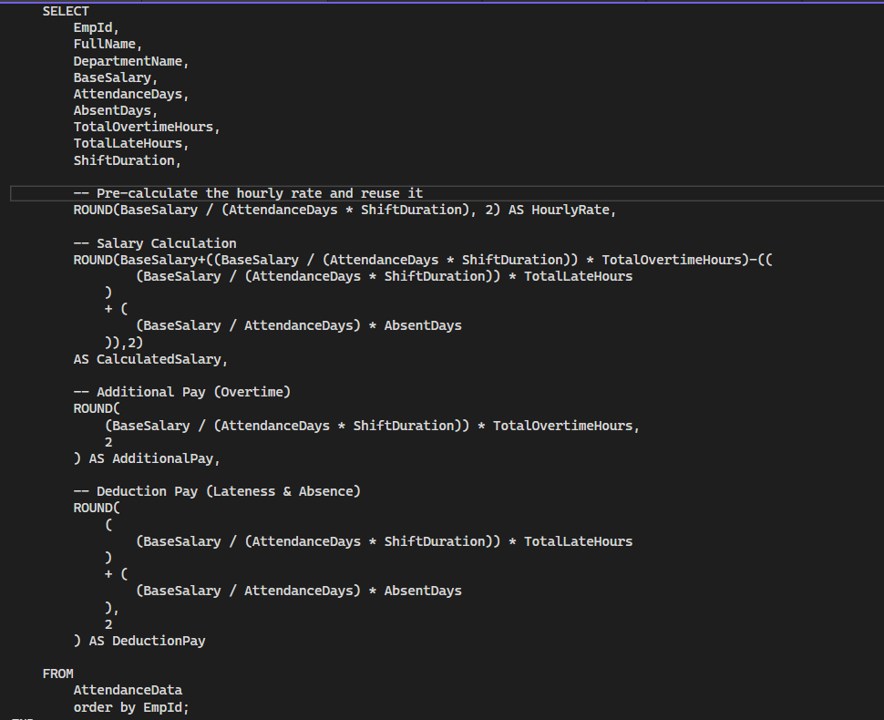

Slide 19
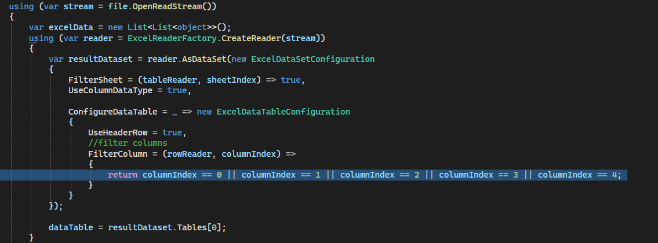

Slide 20
Deployment

Slide 21
The HR Management System (HRMS) is hosted on Microsoft Azure, using SQL Server and SQL Database for data management. Built with .NET 8, the backend is an Azure Web App, and the Angular frontend is also hosted in Azure. This setup enhances monitoring, cost-efficiency, integration, scalability, and security.

Slide 22
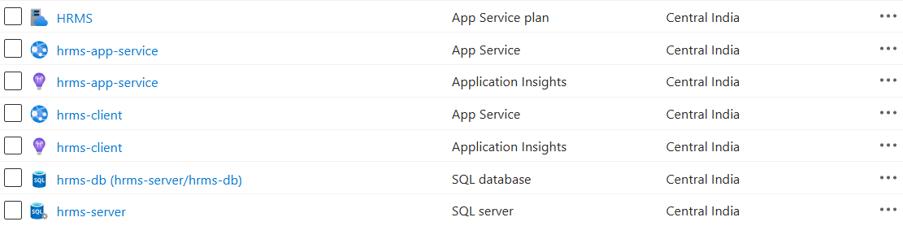

Slide 23
Screenshots

Slide 24
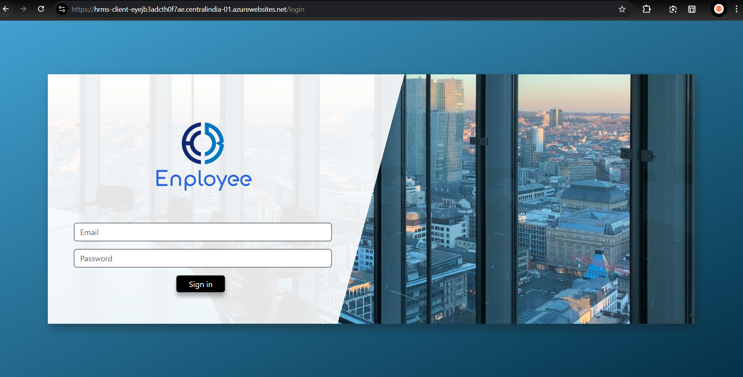

Slide 25
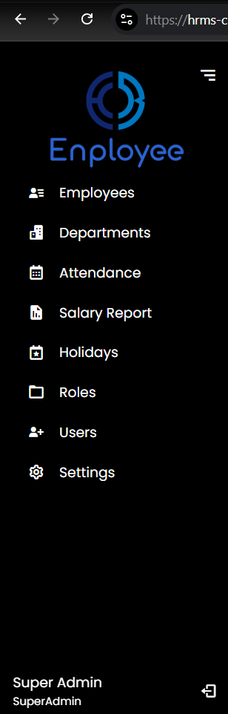
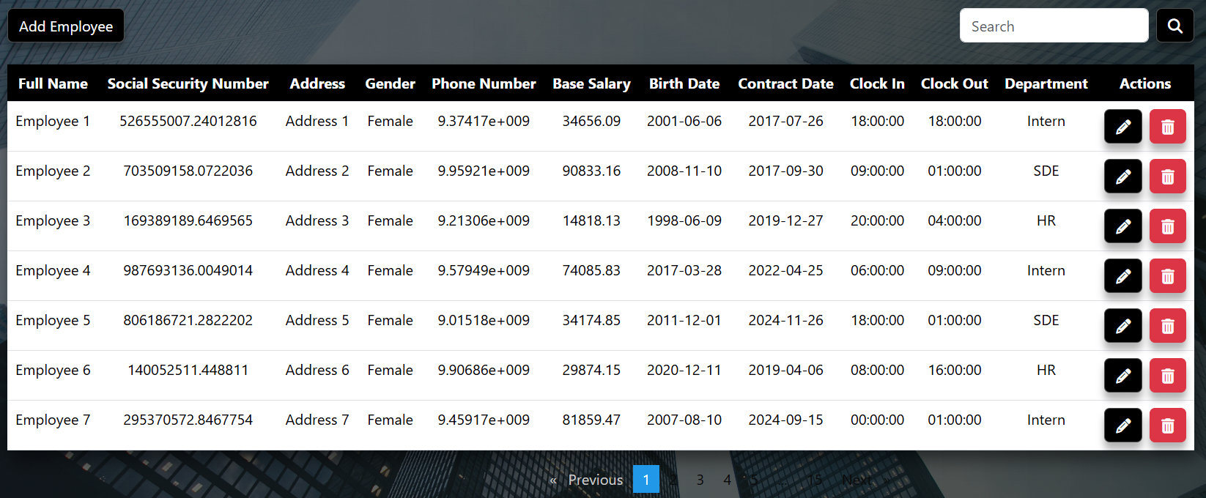

Slide 26
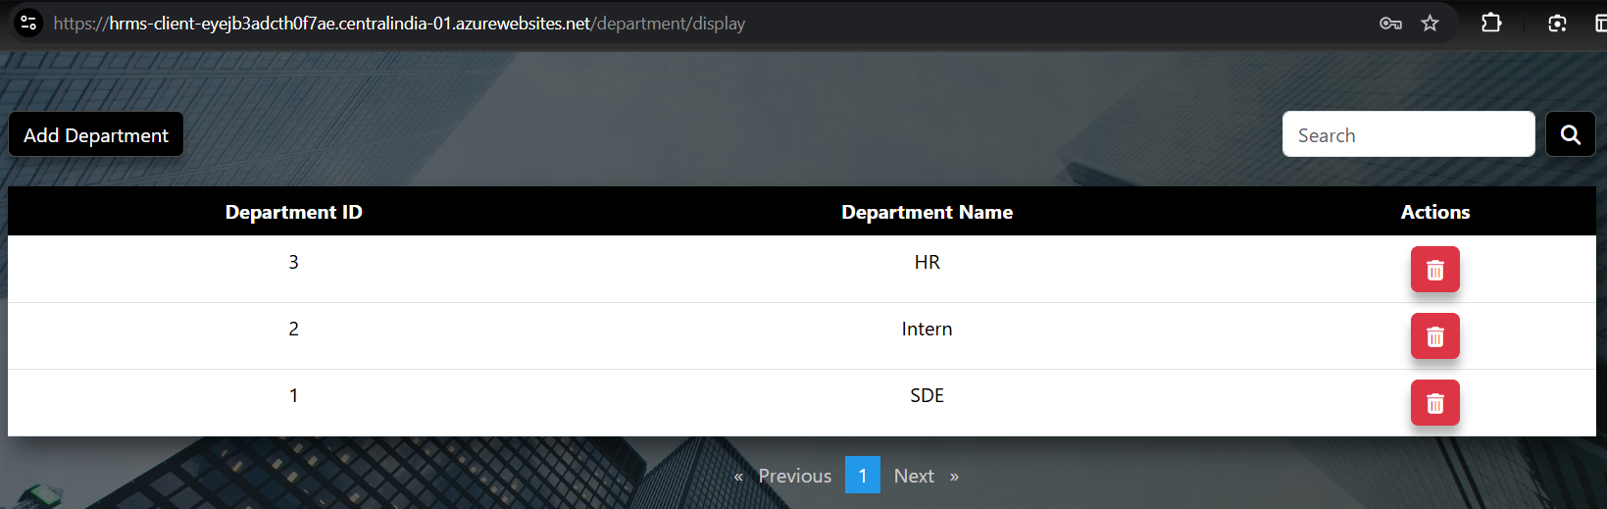

Slide 27
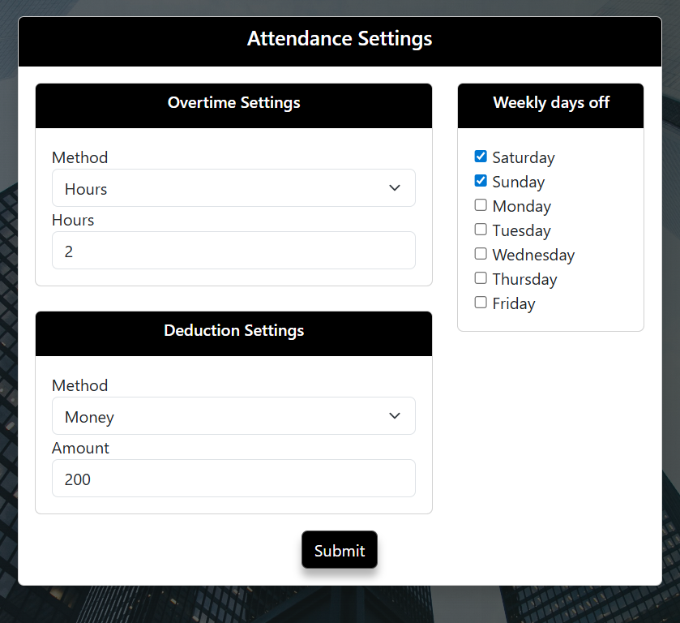

Slide 28
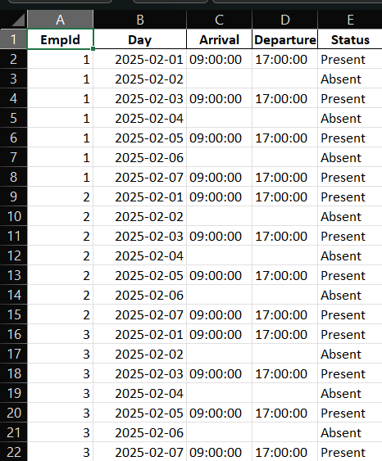

Slide 29
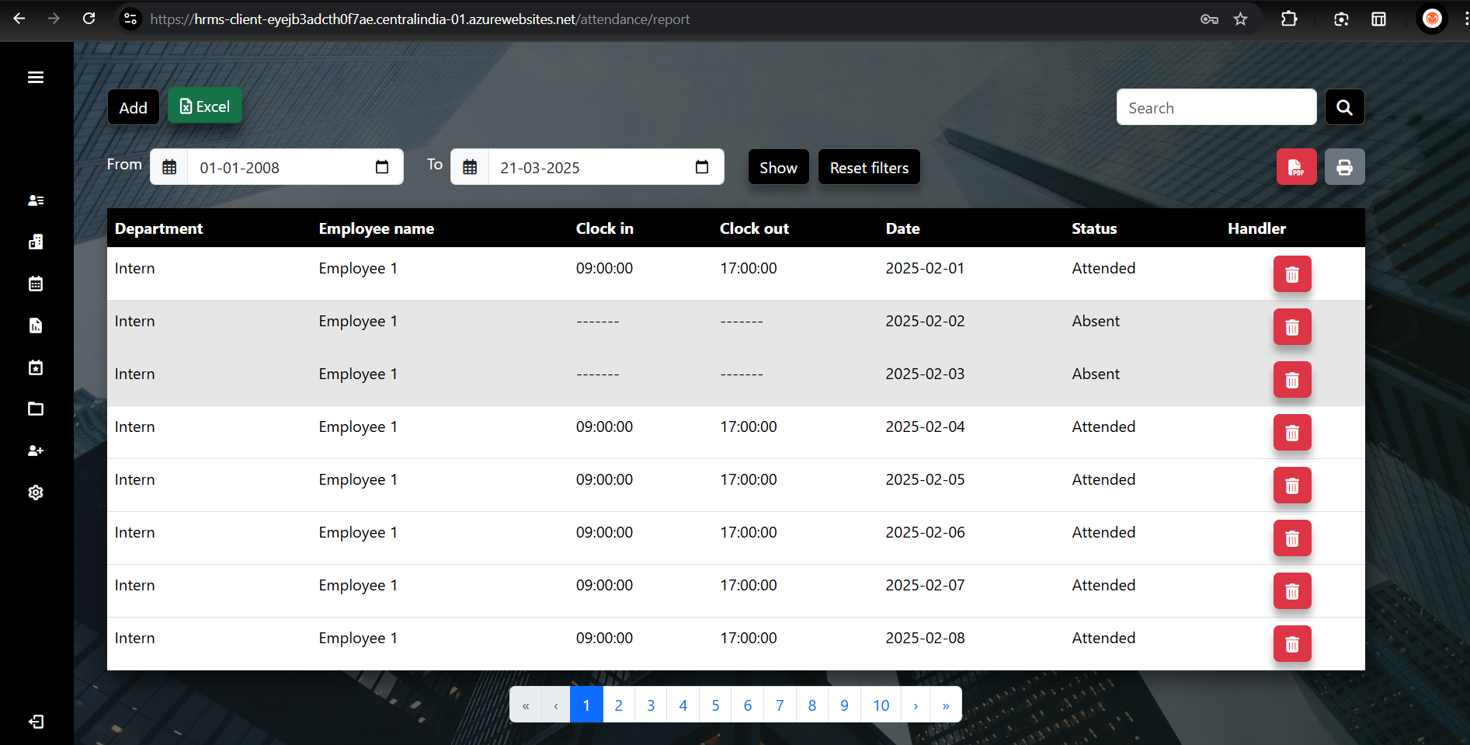

Slide 30
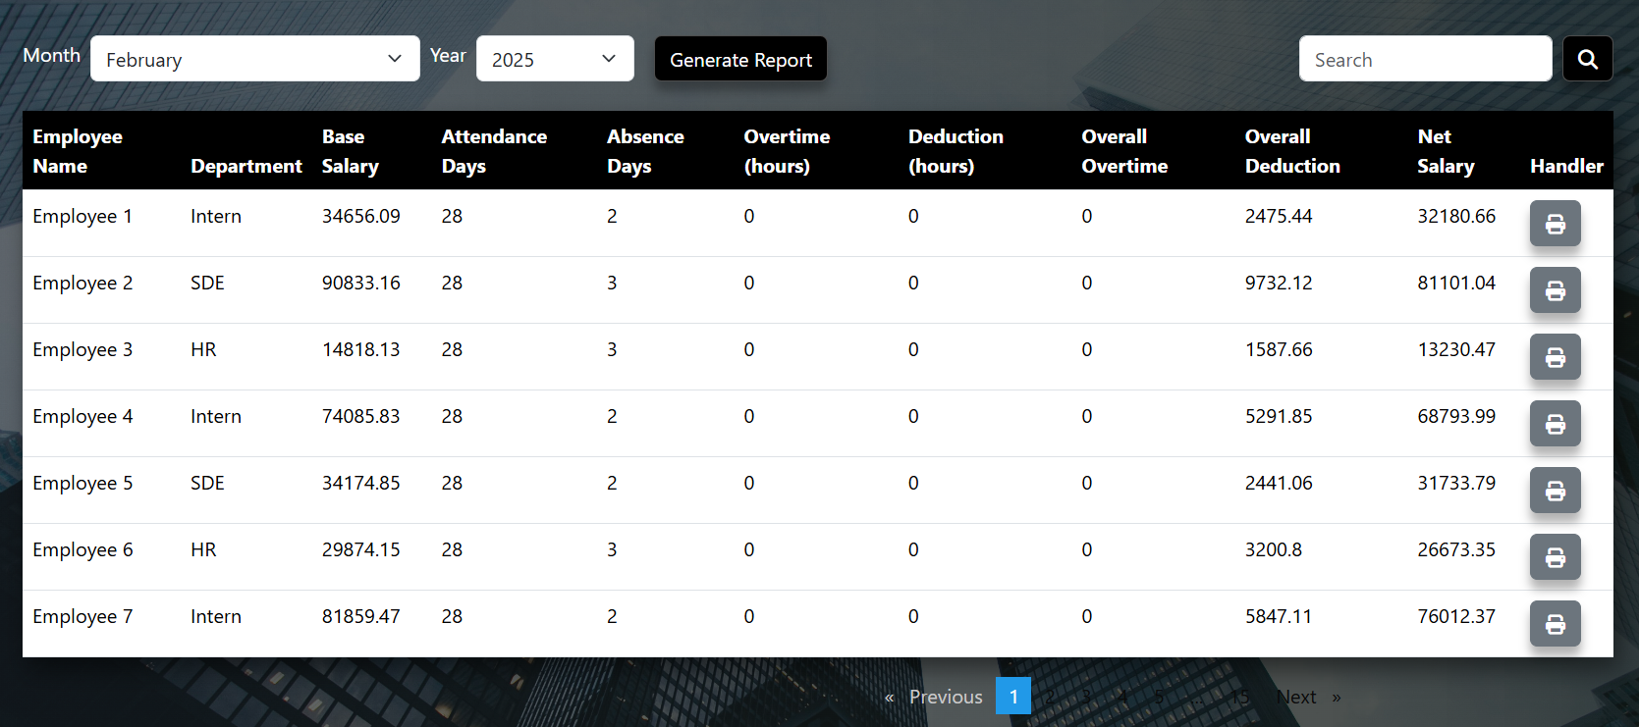

Slide 31

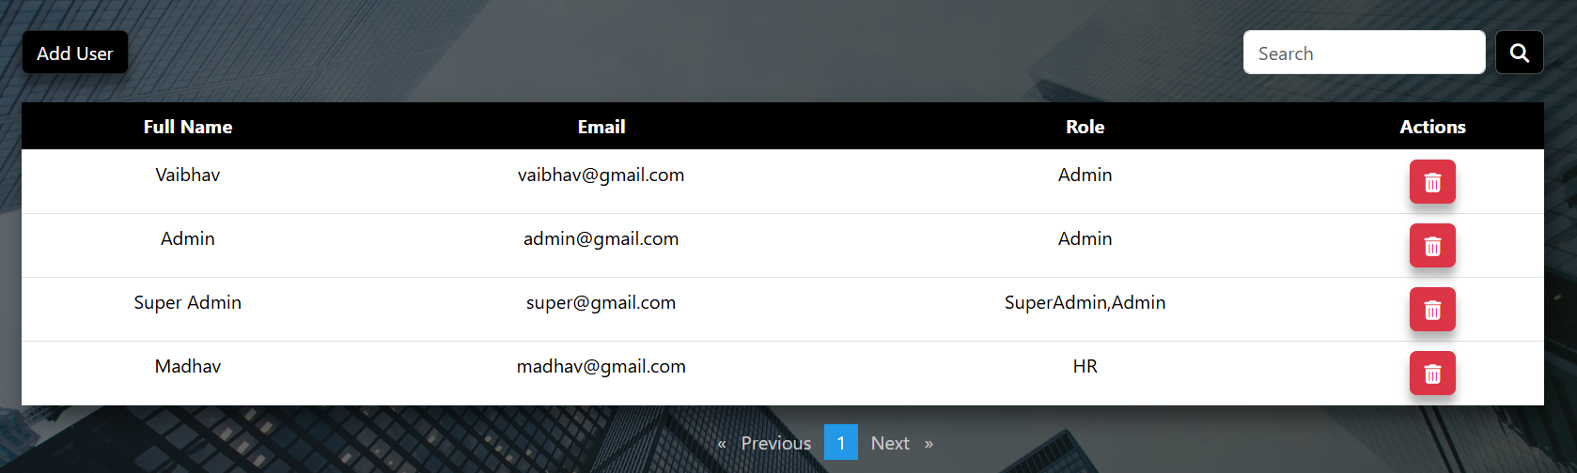

Slide 32
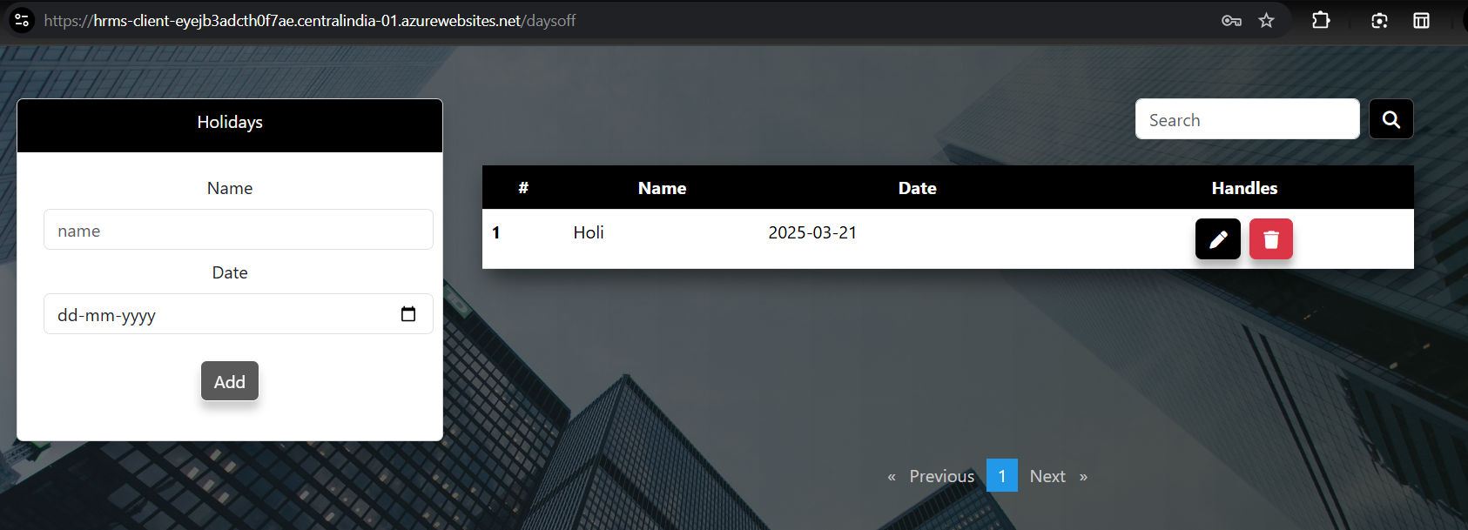

Slide 33
Challenges Faced
Notes:
too much time taken in payroll calculation
integration issues

Slide 34
Future Extensions
Notes:
chat bot integration
concurrency, multithreading

Slide 35
Thank You
Anish Thakkar (CE082)
Vaibhav Makwana (CE024)

